Slide 1
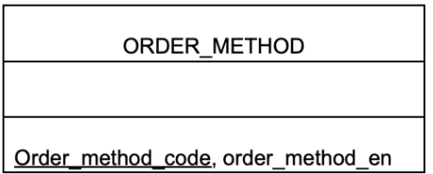
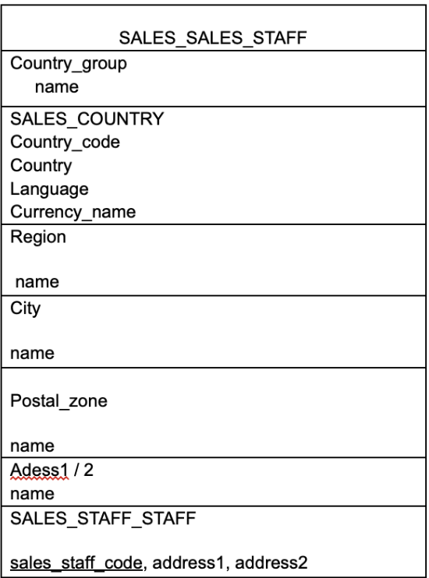
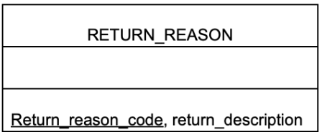
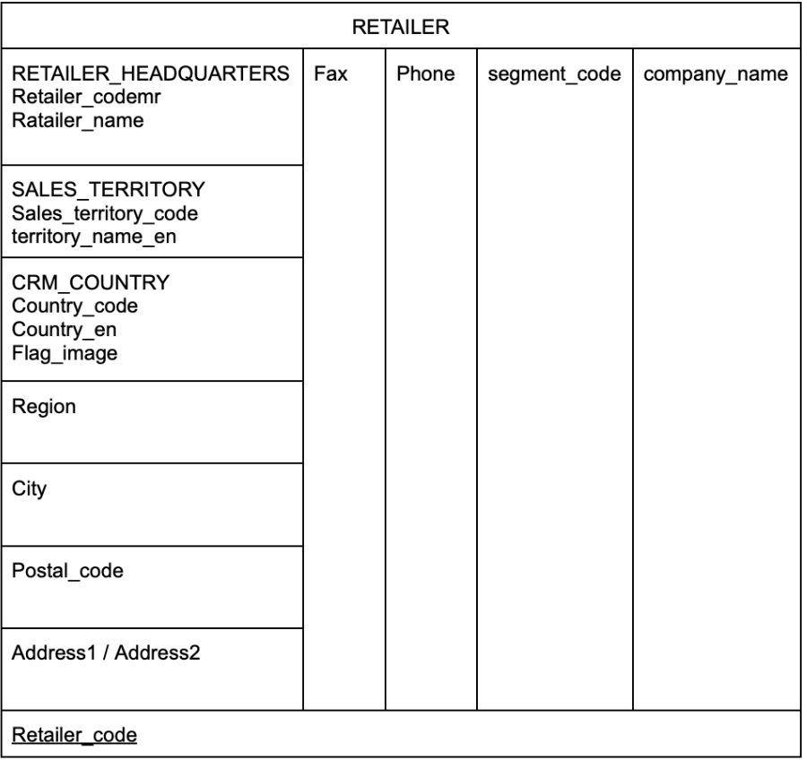
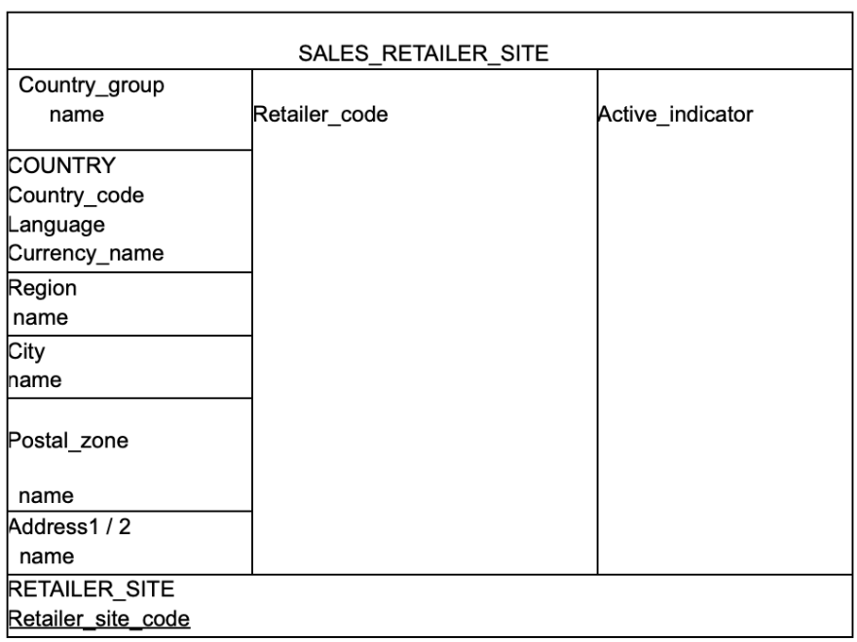
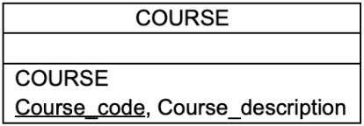
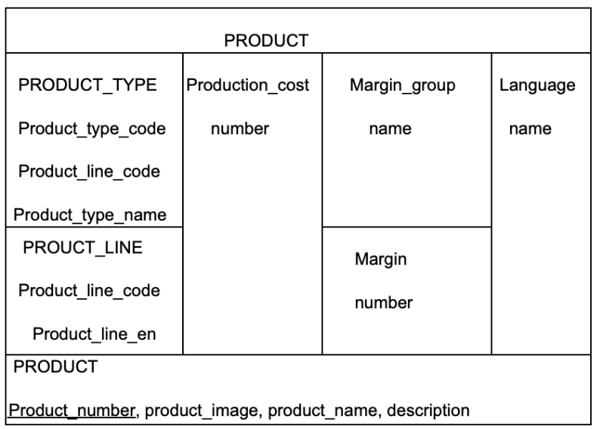
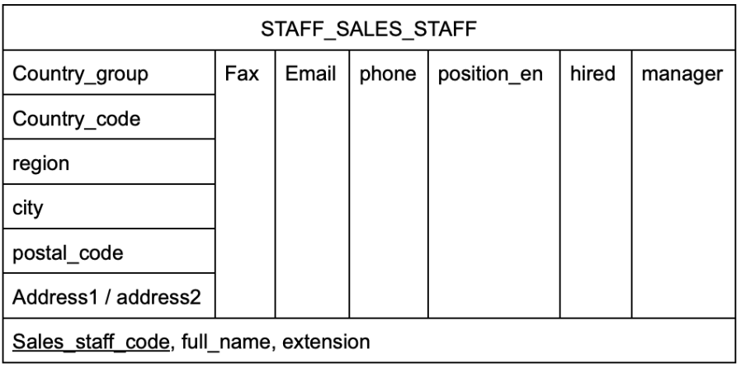
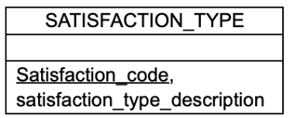
ORDER_DATA
ORDER_DATA_order_number ORDER_DATA_order_detail_code ORDER_DATA_return_code ORDER_DATA_retailer_name ORDER_DATA_quantity ORDER_DATA_unit_cost ORDER_DATA_order_detail_code ORDER_DATA_return_quantity DAY_order_date DAY_return_date PRODUCT_product_number SALES_SALES_STAFF_sales_staff_code RETAILER_retailer_site_code RETAILER_retailer_code ORDER_METHOD_order_method_code RETURN_REASON_return_reason_code
SALES_TARGETDATA
SALES_TARGETDATA_id SALES_TARGETDATA_target SALES_SALES_STAFF_staffcode DAY_year DAY_period RETAILER_retailer_name RETAILER_retailer_code PRODUCTproduct_number
DATE
YEAR
PERIOD
MONTH
DAY
DATE_YEAR
YEAR
GO_SALES_PRODUCT_FORECASTDATA
PRODUCT_product_number DAY_year DAY_month GO_SALES_PRODUCT_FORECASTDATA_expected_volume
YEAR_MONTH
YEAR
MONTH
YEAR_PERIOD
YEAR
PERIOD
GO_SALES_INVENTORY_FORECASTDATA
PRODUCT_product_number DAY_inventory_year DAY_inventory_month GO_SALES_INVENTORY_FORECASTDATA_inventory_count
Training
DATE_YEAR_year STAFF_SALES_STAFF_sales_staff_code COURSE_course_code
SATISFACTION§
DATE_YEAR_year STAFF_SALES_STAFF_sales_staff_code SATISFACTION_TYPE_satisfaction_type_code

